Slide 1
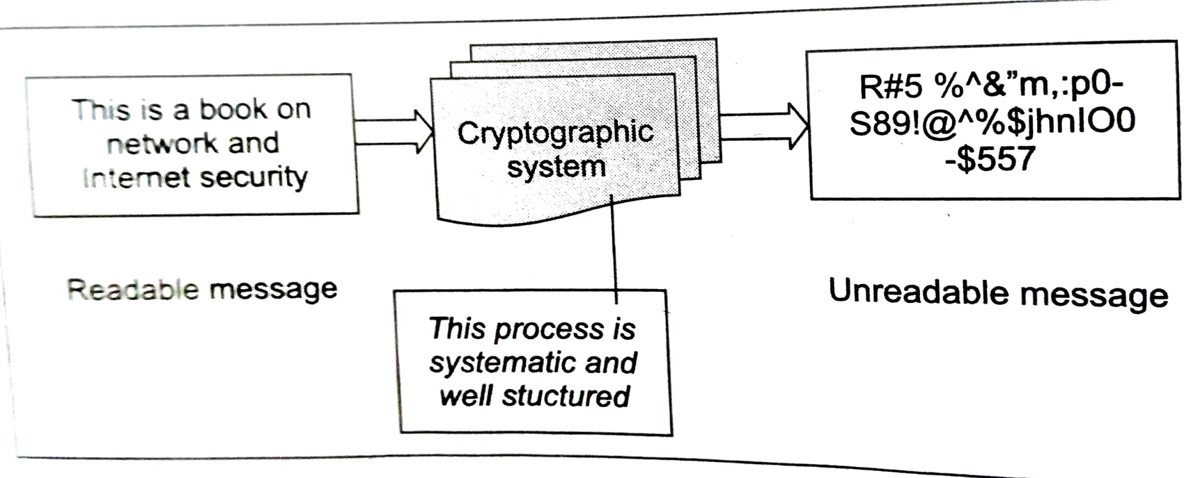
Cryptography:it is an art of achieving security by encoding message to them non-readable.

Slide 2
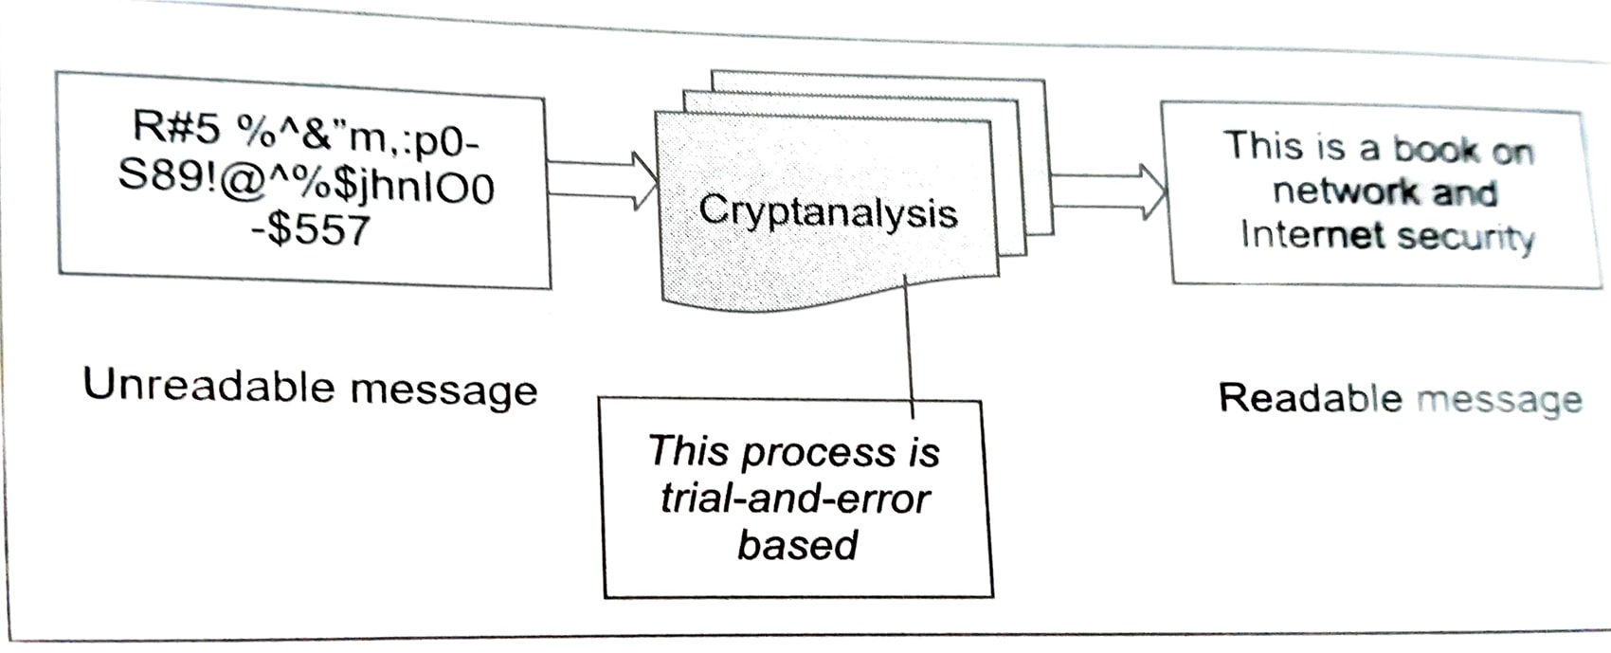
Cryptanalysis:is the technique of decoding message from a non-readable format back to a readable format.

Slide 3
Plain text:signifies a message that can be understood by sender,the recipient and also by anyone else who gets access to that message.
Cipher text:when a plain text message is codified using any suitable scheme, the resulting message is called cipher text.

Slide 4
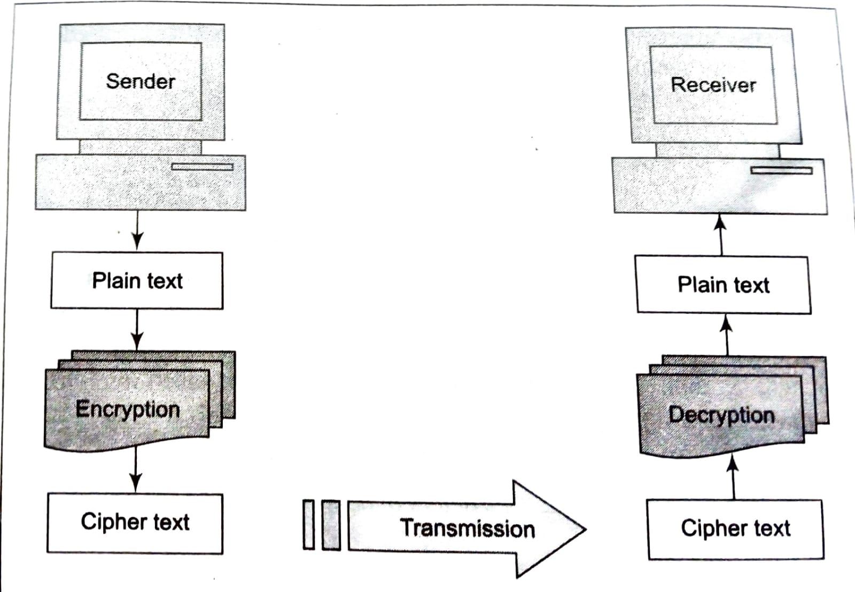
Elements of cryptography system

Slide 5
Transforming a plain text message into cipher text
Substitution technique
Transposition technique

Slide 6
Ceaser cipher:In the substitution cipher technique the character of a plain text message are replced by three places down the alphabet.
Plain text: meet me after the yoga
Cipher text: phhw ph diwhu wkh brjd

Slide 7
Caesar Cipher
can define transformation as:
a b c d e f g h i j k l m n o p q r s t u v w x y z
D E F G H I J K L M N O P Q R S T U V W X Y Z A B C
mathematically give each letter a number
a b c d e f g h i j k l m n o p q r s t u v w x y z
0 1 2 3 4 5 6 7 8 9 10 11 12 13 14 15 16 17 18 19 20 21 22 23 24 25
then have Caesar cipher as:
c = E(p) = (p + k) mod (26)
p = D(c) = (c – k) mod (26)
Notes:
This mathematical description uses modulo (clock) arithmetic. Here, when you reach Z you go back to A and start again. Mod 26 implies that when you reach 26, you use 0 instead (ie the letter after Z, or 25 + 1 goes to A or 0).
Example: howdy (7,14,22,3,24) encrypted using key f (ie a shift of 5) is MTBID

Slide 8
Cryptanalysis of Caesar Cipher
only have 26 possible ciphers
A maps to A,B,..Z
could simply try each in turn
given ciphertext, just try all shifts of letters
do need to recognize when have plaintext
eg. break ciphertext "GCUA VQ DTGCM"
Notes:
With a caesar cipher, there are only 26 possible keys, of which only 25 are of any use, since mapping A to A etc doesn't really obscure the message! Note this basic rule of cryptanalysis "check to ensure the cipher operator hasn't goofed and sent a plaintext message by mistake"!
Can try each of the keys (shifts) in turn, until can recognise the original message. See Stallings Fig 2.3 for example of search.
Note: as mentioned before, do need to be able to recognise when have an original message (ie is it English or whatever). Usually easy for humans, hard for computers. Though if using say compressed data could be much harder.
Example "GCUA VQ DTGCM" when broken gives "easy to break", with a shift of 2 (key C).

Slide 9
Monoalphabetic Cipher
rather than just shifting the alphabet
could shuffle (jumble) the letters arbitrarily
each plaintext letter maps to a different random ciphertext letter
hence key is 26 letters long
Plain: abcdefghijklmnopqrstuvwxyz
Cipher: DKVQFIBJWPESCXHTMYAUOLRGZN
Plaintext: ifwewishtoreplaceletters
Ciphertext: WIRFRWAJUHYFTSDVFSFUUFYA
Notes:
With only 25 possible keys, the Caesar cipher is far from secure. A dramatic increase in the key space can be achieved by allowing an arbitrary substitution, where the translation alphabet can be any permutation of the 26 alphabetic characters.
See example translation alphabet, and an encrypted message using it.

Slide 10
Monoalphabetic Cipher Security
now have a total of 26! = 4 x 1026 keys
with so many keys, might think is secure
but would be !!!WRONG!!!
problem is language characteristics
Notes:
Note that even given the very large number of keys, being 10 orders of magnitude greater than the key space for DES, the monoalphabetic substitution cipher is not secure, because it does not sufficiently obscure the underlying language characteristics.

Slide 11
Language Redundancy and Cryptanalysis
human languages are redundant
eg "th lrd s m shphrd shll nt wnt"
letters are not equally commonly used
in English E is by far the most common letter
followed by T,R,N,I,O,A,S
other letters like Z,J,K,Q,X are fairly rare
have tables of single, double & triple letter frequencies for various languages
Notes:
As the example shows, we don't actually need all the letters in order to understand written English text. Here vowels were removed, but they're not the only redundancy. cf written Hebrew has no vowels for same reason. Are usually familiar with "party conversations", can hear one person speaking out of hubbub of many, again because of redundancy in aural language also. This redundancy is also the reason we can compress text files, the computer can derive a more compact encoding without losing any information. Basic idea is to count the relative frequencies of letters, and note the resulting pattern.

Slide 12
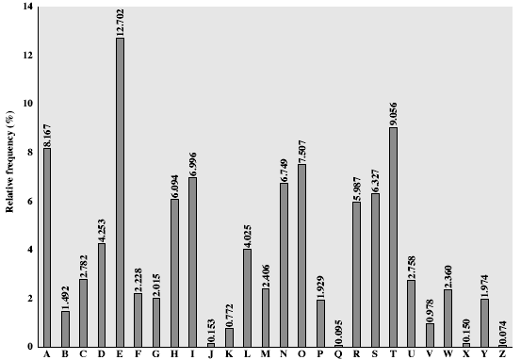
English Letter Frequencies
Notes:
Note that all human languages have varying letter frequencies, though the number of letters and their frequencies varies. Stallings Figure 2.5 shows English letter frequencies. Seberry & Pieprzyk, "Cryptography - An Introduction to Computer Security", Prentice-Hall 1989, Appendix A has letter frequency graphs for 20 languages (most European & Japanese & Malay).

Slide 13
Use in Cryptanalysis
key concept - monoalphabetic substitution ciphers do not change relative letter frequencies
calculate letter frequencies for ciphertext
compare counts/plots against known values
if caesar cipher look for common peaks/troughs
peaks at: A-E-I triple, NO pair, RST triple
troughs at: JK, X-Z
for monoalphabetic must identify each letter
tables of common double/triple letters help
Notes:
The simplicity and strength of the monoalphabetic substitution cipher meant it dominated cryptographic use for the first millenium AD. It was broken by Arabic scientists. The earliest known description is in Abu al-Kindi's "A Manuscript on Deciphering Cryptographic Messages", published in the 9th century but only rediscovered in 1987 in Istanbul, but other later works also attest to their knowledge of the field. Monoalphabetic ciphers are easy to break because they reflect the frequency data of the original alphabet. The cryptanalyst looks for a mapping between the observed pattern in the ciphertext, and the known source language letter frequencies. If English, look for peaks at: A-E-I triple, NO pair, RST triple, and troughs at: JK, X-Z.

Slide 14
Example Cryptanalysis
given ciphertext:
UZQSOVUOHXMOPVGPOZPEVSGZWSZOPFPESXUDBMETSXAIZ
VUEPHZHMDZSHZOWSFPAPPDTSVPQUZWYMXUZUHSX
EPYEPOPDZSZUFPOMBZWPFUPZHMDJUDTMOHMQ
count relative letter frequencies (see text)
guess P & Z are e and t
guess ZW is th and hence ZWP is the
proceeding with trial and error finally get:
it was disclosed yesterday that several informal but
direct contacts have been made with political
representatives of the viet cong in moscow
Notes:
Illustrate the process with this example from the text in Stallings section 2.2.

Slide 15
Playfair Cipher
not even the large number of keys in a monoalphabetic cipher provides security
one approach to improving security was to encrypt multiple letters
the Playfair Cipher is an example
invented by Charles Wheatstone in 1854, but named after his friend Baron Playfair
Notes:
Consider ways to reduce the "spikyness" of natural language text, since if just map one letter always to another, the frequency distribution is just shuffled. One approach is to encrypt more than one letter at once. The Playfair cipher is an example of doing this.

Slide 16
Playfair Key Matrix
a 5X5 matrix of letters based on a keyword
fill in letters of keyword (sans duplicates)
fill rest of matrix with other letters
eg. using the keyword MONARCHY
M | O | N | A | R
C | H | Y | B | D
E | F | G | I/J | K
L | P | Q | S | T
U | V | W | X | Z
Notes:
The best-known multiple-letter encryption cipher is the Playfair, which treats digrams in the plaintext as single units and translates these units into ciphertext digrams. The Playfair algorithm is based on the use of a 5x5 matrix of letters constructed using a keyword. The rules for filling in this 5x5 matrix are: L to R, top to bottom, first with keyword after duplicate letters have been removed, and then with the remain letters, with I/J used as a single letter. This example comes from Dorothy Sayer's book "Have His Carcase", in which Lord Peter Wimsey solves it, and describes the use of a probably word attack.

Slide 17
Encrypting and Decrypting
plaintext is encrypted two letters at a time
if a pair is a repeated letter, insert filler like 'X’
if both letters fall in the same row, replace each with letter to right (wrapping back to start from end)
if both letters fall in the same column, replace each with the letter below it (again wrapping to top from bottom)
otherwise each letter is replaced by the letter in the same row and in the column of the other letter of the pair
Notes:
Plaintext is encrypted two letters at a time,according to the rules as shown. Note how you wrap from right side back to left, or from bottom back to top.
if a pair is a repeated letter, insert a filler like 'X', eg. "balloon" encrypts as "ba lx lo on"
if both letters fall in the same row, replace each with letter to right (wrapping back to start from end), eg. “ar" encrypts as "RM"
if both letters fall in the same column, replace each with the letter below it (again wrapping to top from bottom), eg. “mu" encrypts to "CM"
otherwise each letter is replaced by the one in its row in the column of the other letter of the pair, eg. “hs" encrypts to "BP", and “ea" to "IM" or "JM" (as desired)
Decrypting of course works exactly in reverse. Can see this by working the example pairs shown, backwards.

Slide 18
Security of Playfair Cipher
security much improved over monoalphabetic
since have 26 x 26 = 676 digrams
would need a 676 entry frequency table to analyse (verses 26 for a monoalphabetic)
and correspondingly more ciphertext
was widely used for many years
eg. by US & British military in WW1
it can be broken, given a few hundred letters
since still has much of plaintext structure
Notes:
The Playfair cipher is a great advance over simple monoalphabetic ciphers, since there are 26*26=676 digrams (vs 26 letters), so that identification of individual digrams is more difficult. Also,the relative frequencies of individual letters exhibit a much greater range than that of digrams, making frequency analysis much more difficult. The Playfair cipher was for a long time considered unbreakable. It was used as the standard field system by the British Army in World War I and still enjoyed considerable use by the U.S.Army and other Allied forces during World War II. Despite this level of confidence in its security,the Playfair cipher is relatively easy to break because it still leaves much of the structure of the plaintext language intact

